Slide 1
Division of Accountability
School Readiness and PGCPS Prekindergarten Participation, SY22
Department of Testing, Research and Evaluation
December 16, 2021
Berhane B. Araia, Ph.D

Slide 2
study Purpose and Scope
Display the level of Pre-K participation in SY2021 and compare it to participation in previous pre-covid school years.
Display the impact of PGCPS pre-K participation on school readiness for SY2022
Compare differences in the relative impact of PGCPS’ programs for FARM eligible, English Language Learners and students with IEP plans.
Notes:
PGCPS Prekindergarten participation: Using enrollment files from the year preceding kindergarten entry, we identified kindergarten students who were enrolled in a PGCPS prekindergarten program. An indicator variable was created to denote pre-K enrollment.
Type of Prekindergarten Program: Using data provided by the Early Childhood Education office, we identified the pre-K programs that provided full- or half-day instruction. We then created an indicator variable to denote the type of pre-K program each student attended.

Slide 3
Pre-K status of KRA test takers, SY2020 & SY2022
Prekindergarten Experience | N | % of Total
No PGCPS Prek Experience | 7127 | 85.1%
PGCPS Full-Day PreK | 941 | 11.2%
PGCPS Full-Day Montosseri | 150 | 1.8%
PGCPS Special Educ Prek Experience | 78 | 0.93%
PGCPS Half-Day PreK | 77 | 0.92%
All | 8373 | 100.%
 | SY20 | SY22
Number of Students tested | 10,008 | 8,373
Number of Kindergarten students who were enrolled in a PGCPS pre-K program the previous school year | 5,754 | 1,246
% of KRA test takers were enrolled in a PGCPS pre-K program the previous school year | 58% | 15%
Notes:
For SY22 Kindergarten Cohort- Only 15% had prior experience with PGCSP Prekindergarten Programs (About 11% attended Full-Day regular Pre-K programs).
The number of Kindergarten students who were enrolled in a PGCPS pre-K program the previous school year was significantly lower, 15% of those who completed the KRA assessment, in SY2022 compared to SY2020- the last time KRA was administered. About 58% of the SY2020 Kindergarteners had attended pre-K in PGCPS.

Slide 4
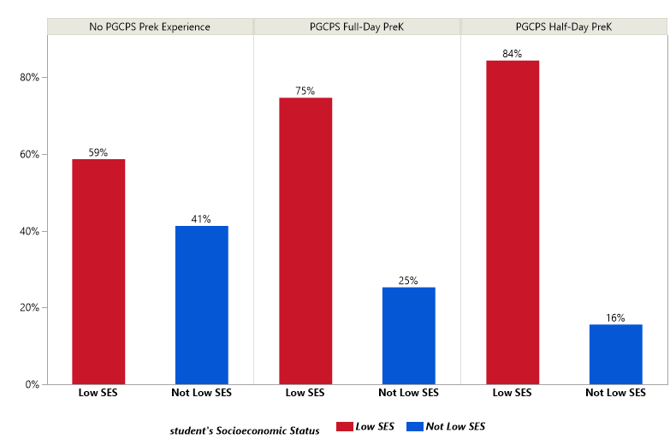
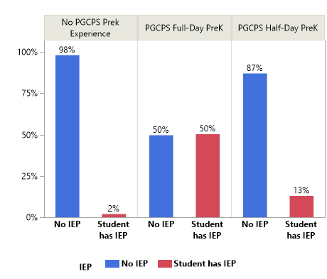
Status of KRA test takers, SY2022
Notes:
For SY22 Kindergarten Cohort-
The overwhelming majority of regular PGCPS Pre-K program attendees (excluding Montessori and Special Education Pre-K enrollees) come from families with Low socioeconomic status
About 8% of all KRA test takers have IEP plan: only 2% of Kindergarteners with no PGCPS pre-K attendance have IEP plans but half of those who were in PGCPS regular Full-Day pre-K programs have IEP as Kindergarten students.

Slide 5
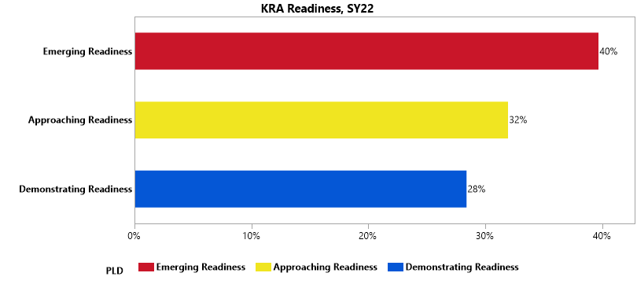
PGCPS Kindergarten Readiness
Notes:
Overall 28% of test-takers Demonstrated Readiness for Kindergarten in SY22. for comparison, IN SY20 the overall school readiness for KRA test takers was 35%

Slide 6
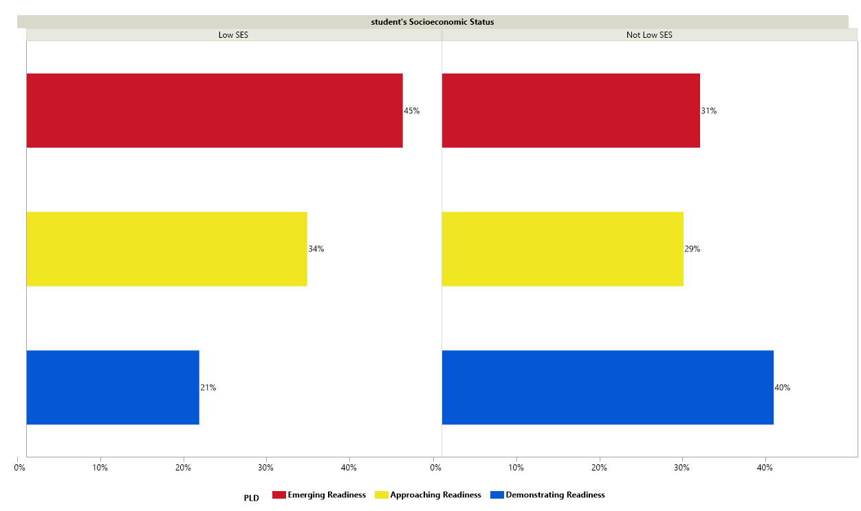
PGCPS Kindergarten Readiness, by Socio-Economic Status
Notes:
Overall, there is a big gap in readiness for school by socio-economic status. The rate of school readiness for students from families with low income is almost half of the rate for students of higher economic status (21% vs 40%).

Slide 7
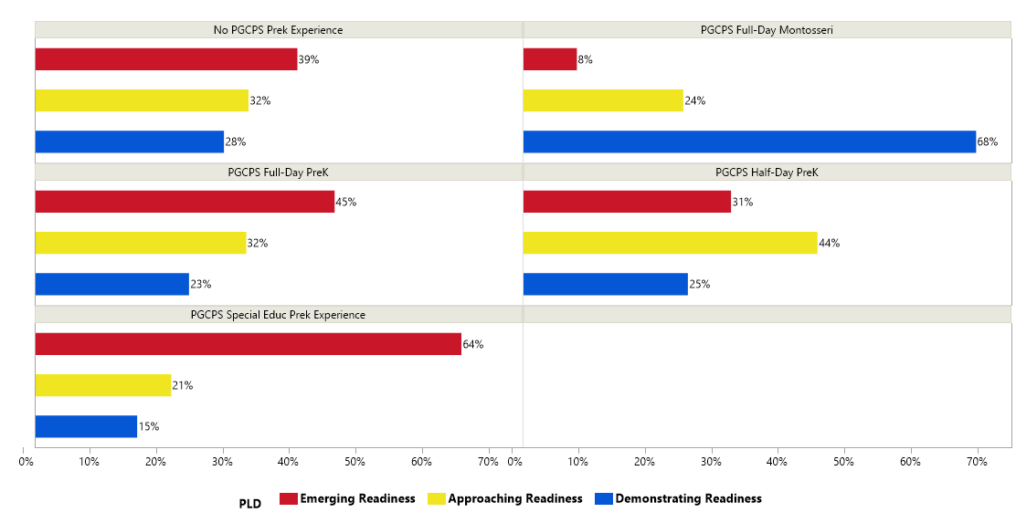
PGCPS Kindergarten Readiness, by pre-K Status
Notes:
Statistical test shows that PGCPS Full-Day enrollees had significantly lower rate of school readiness (p=.0007) compared to those with out PGCPS pre-K experience, when other characteristics of the students are not taken into account.

Slide 8
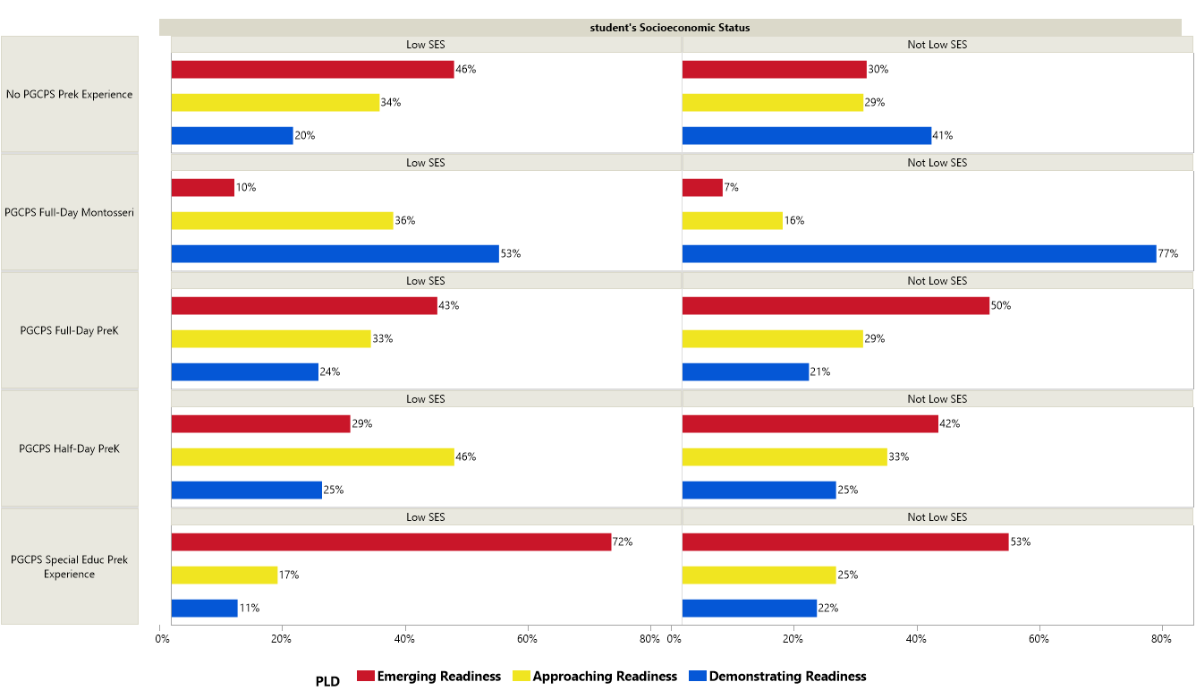
PGCPS Kindergarten Readiness, by pre-K & Socioeconomic Status
Notes:
Students from families with lower income (low SES) who attended PGPS Pre-K programs (Full-Day and Half-Day) demonstrated higher rates of school readiness than students from similar families who had no PGCPS Pre-K experiences. For example, Full-Day pre-K compared to No PGCPS pre-K experience has statistically significant effect with odd-ratio of 1.27 (p=.0118). Note that the majority of pre-K enrollees in PGCPS were from low income families.
Moreover, among PGCPS pre-K participants students from lower income families demonstrate better or as much as those students from higher income families.

Slide 9
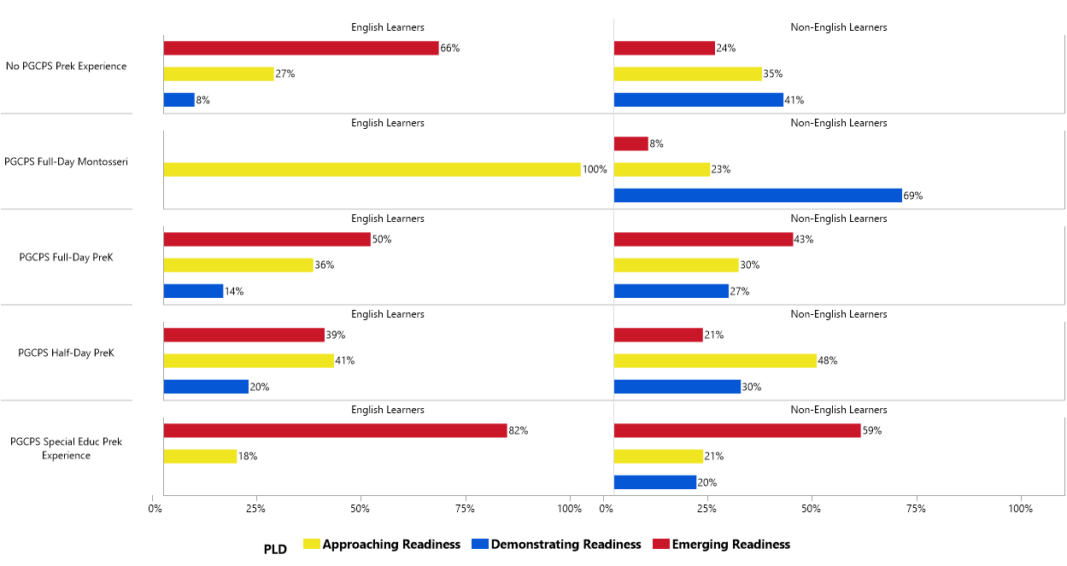
PGCPS Kindergarten Readiness, by pre-K & ELL Status
Notes:
English Learners (ELL) who attended PGPS Pre-K programs (Full-Day and Half-Day) demonstrated higher rates of school readiness than ELL students who had no PGCPS Pre-K experiences.
ELL in both Full Day and Half-Day programs have spastically significant higher odds of school readiness
Moreover, ELL PGCPS pre-K participants have smaller gap in readiness for school compared to their non-ELL counterparts.

Slide 10
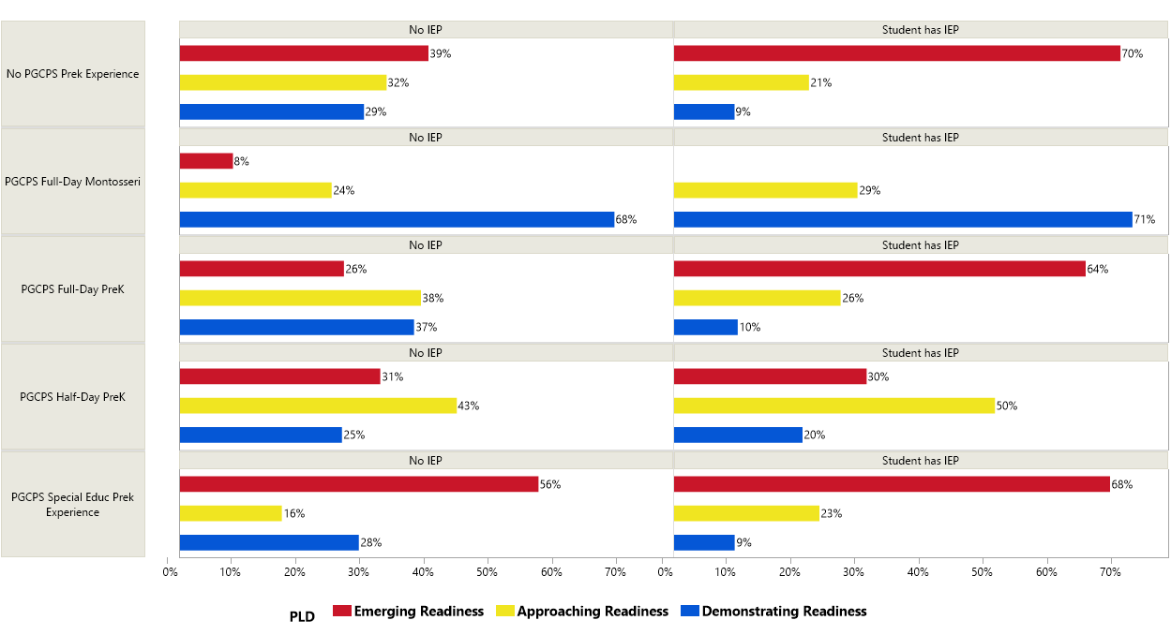
PGCPS Kindergarten Readiness, by pre-K & SPED Status
Notes:
Among students with no IEP plans, Full-Day PGCPS pre-K attended demonstrate more readiness than students who did not attend PGCPS pre-K programs.
Non-IEP Full-day increased school readiness significantly; odds ratio of 1.42 (p=.0003).
For students with IEP participation in PGCPS program did not result in any significant statistical difference in school readiness compared to students who did not enroll in PGCPS pre-K programs. Note that half of SY2 Kindergarten class who also attended PGCPS full-day pre-K have IEP plans.

Slide 11
Key Findings
Overall, PGCPS pre-K participants did not have higher rates of kindergarten readiness compared to those students who did not attend PGCPS pre-K programs.
However, once we took into account the socio-demographic characteristics of students, participation in PGCPS pre-K program is associated with increasing the odds of school readiness.
Especially for students with low socioeconomic status and English learners, enrollment in PGCPS pre-K program increased their readiness for school.
PGCPS pre-K enrollees who are not special education services recipients during kindergarten demonstrated higher rates of school readiness compared to their counterparts who did not enroll in PGCPS pre-K program.

