Slide 1

John Hanson Montessori School at
Potomac Landing
Update Discussion
Friday, November 21, 2025

Slide 2

Agenda
Welcome & Introductions
Placement of Modulars/Aesthetics
Facility Upgrades
Timeline
Operations
Security
Transportation
Discussion

Slide 3
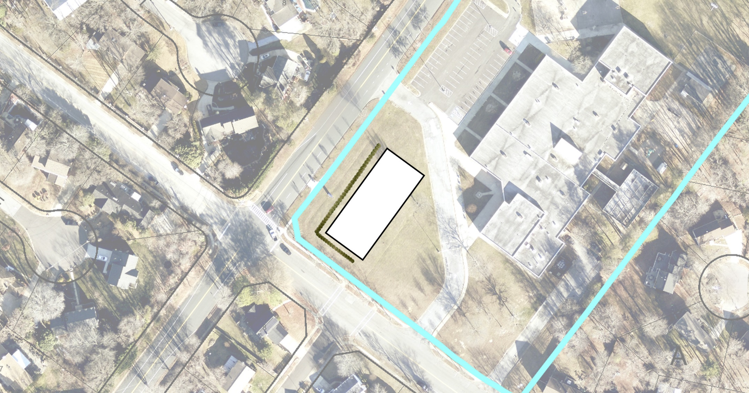
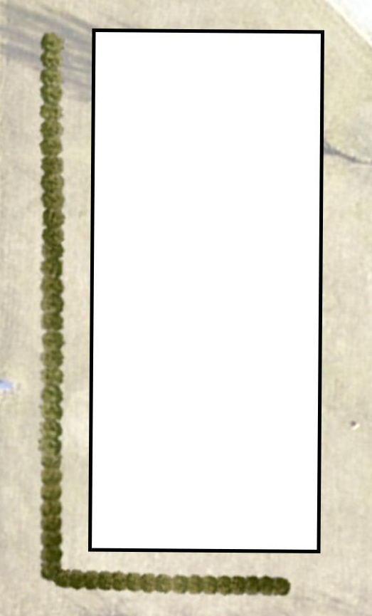
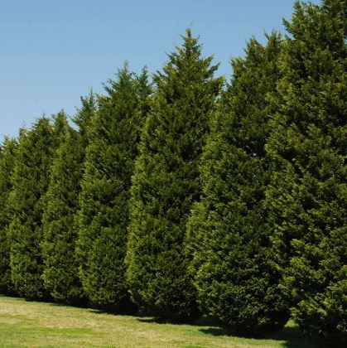
Concept Idea: Simple evergreen screening using a fast-growing tree species with a dense growth habit.
Concept 1:
POTOMAC LANDING ES
EAST TANTALLON DRIVE
FORT WASHINGTON ROAD
PROPOSED EVERGREEN SCREENING
PROPOSED MODULAR BUILDING

Slide 4
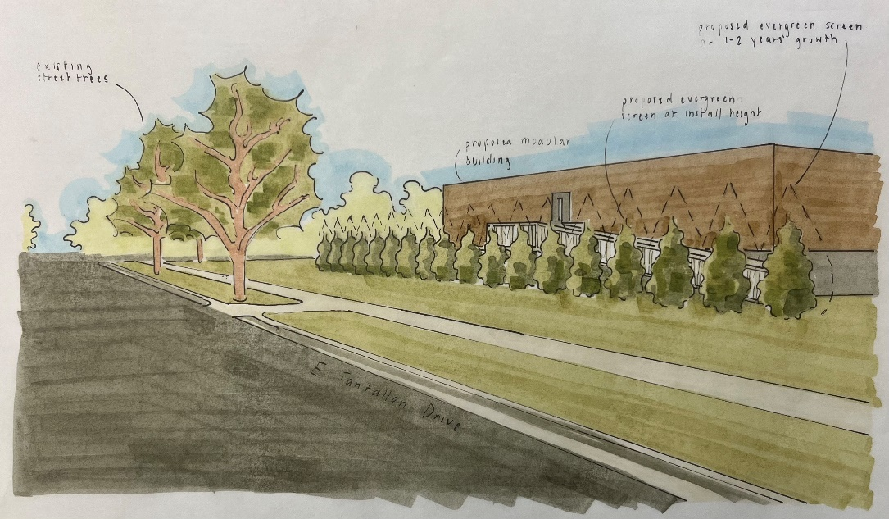
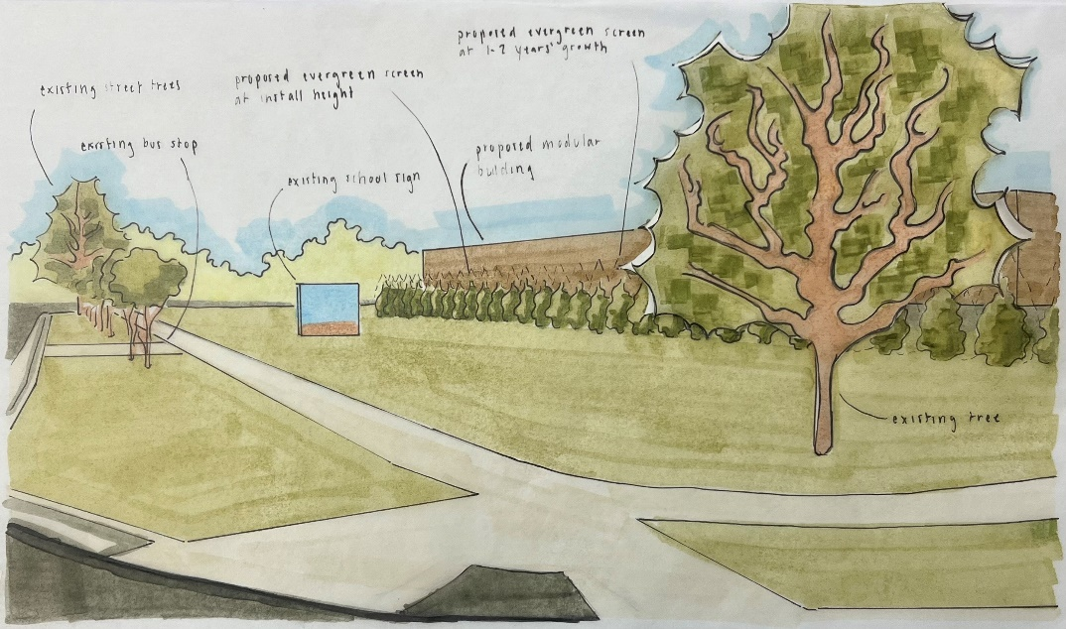
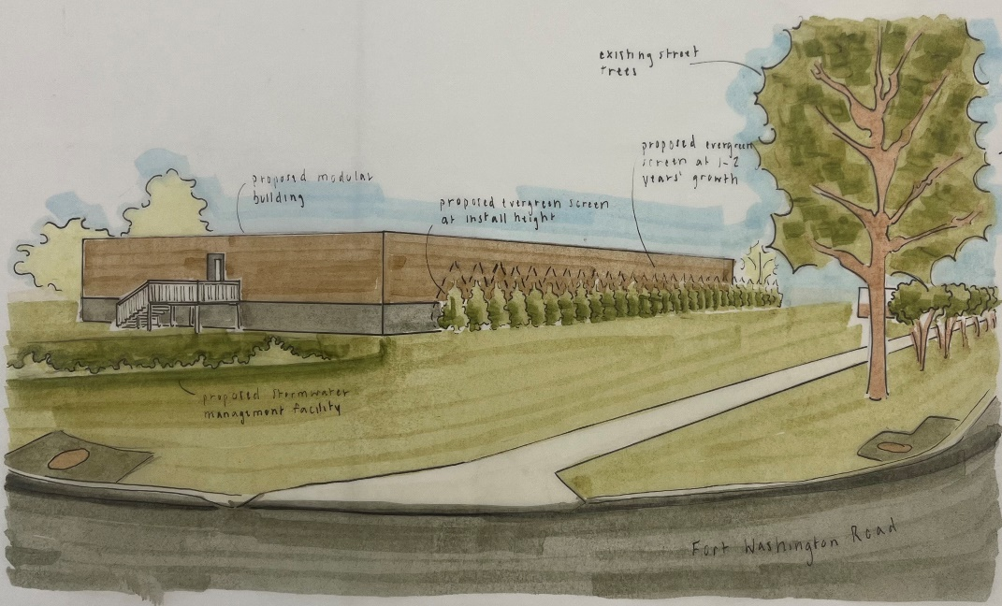
Concept 1: Sketches
From E Tantallon Drive
From the Intersection of E Tantallon and Fort Washington
From Fort Washington Road

Slide 5
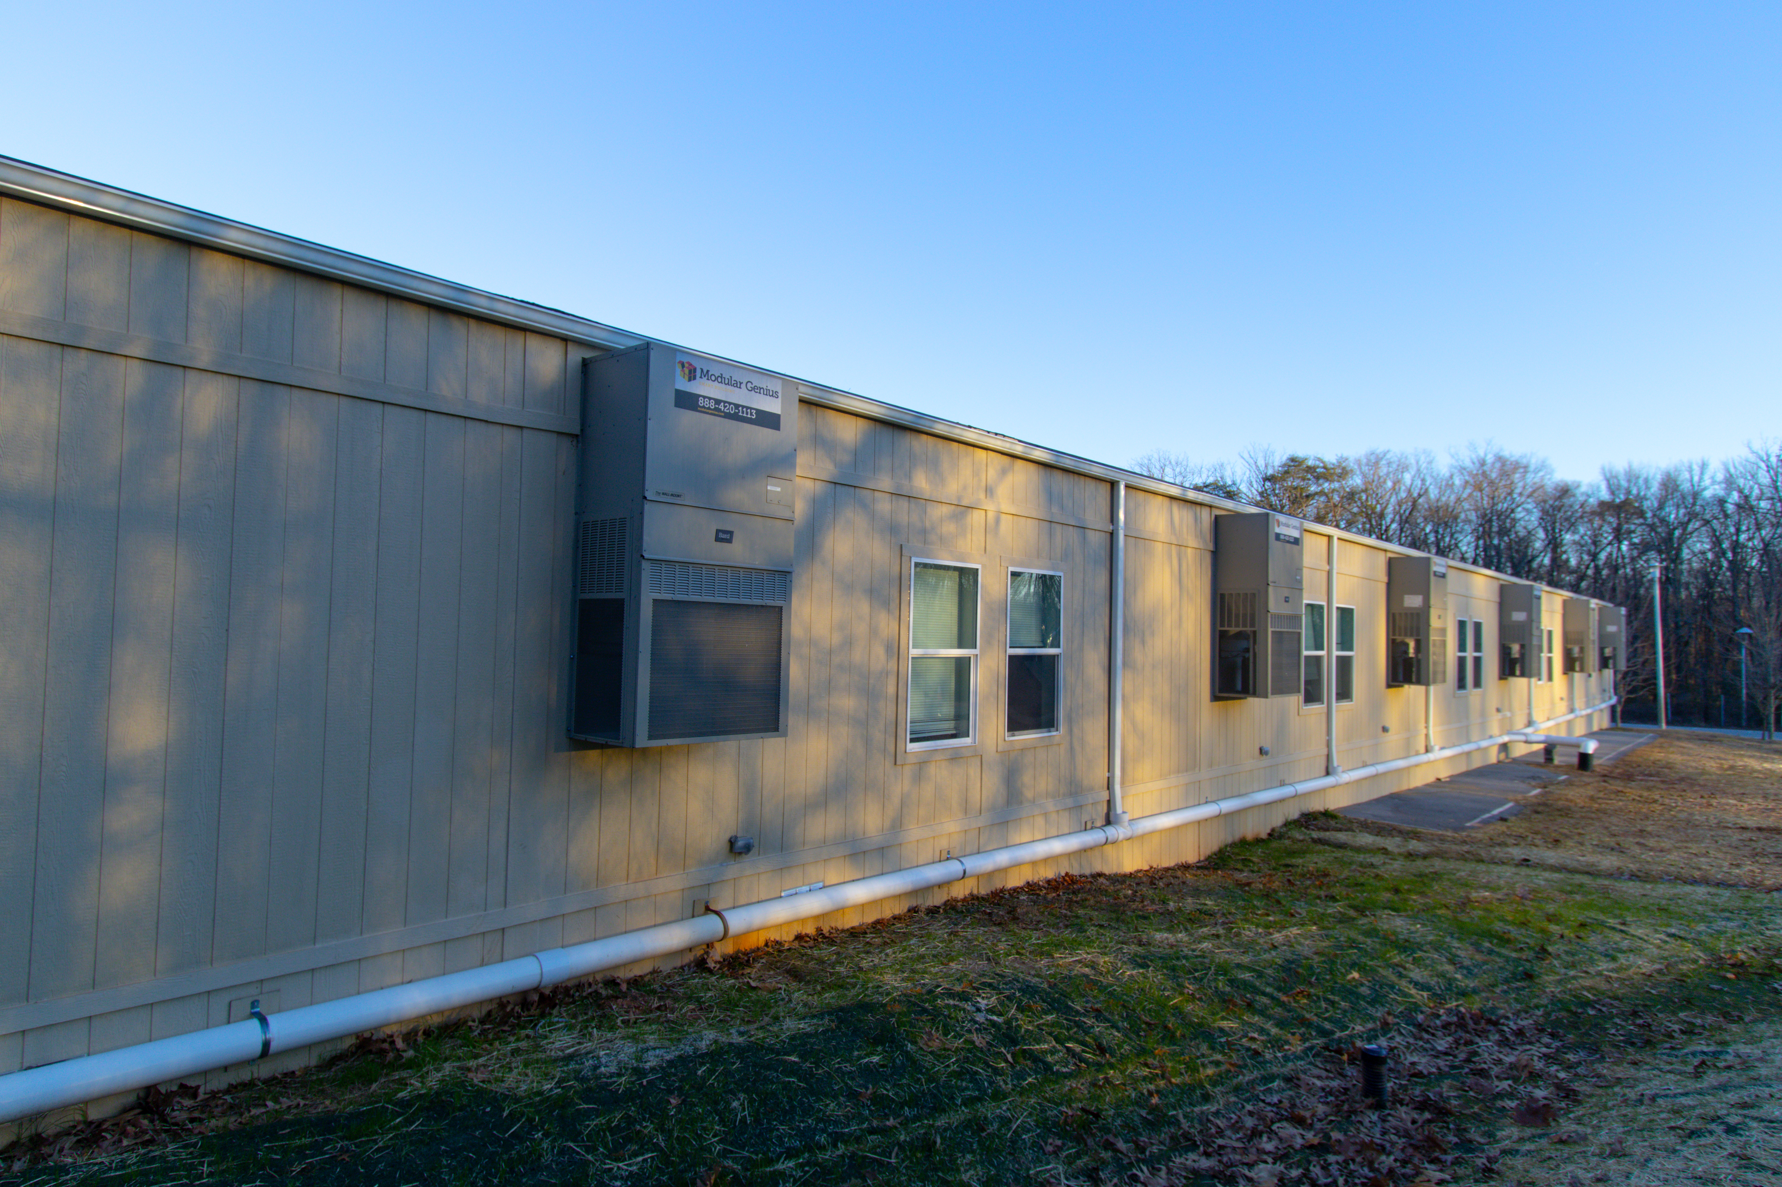
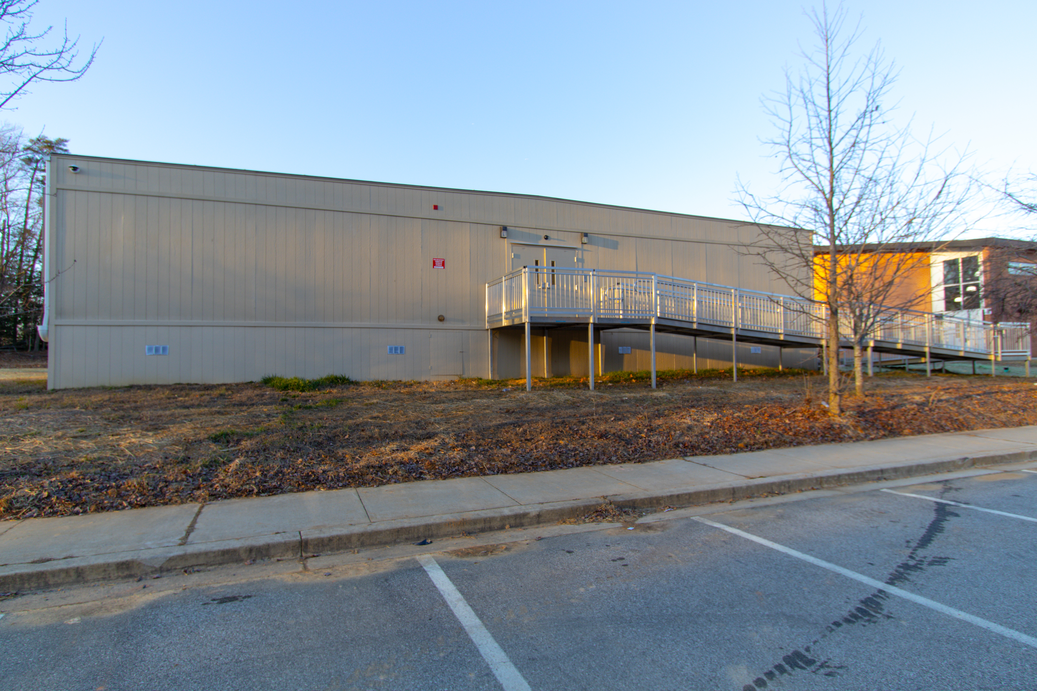
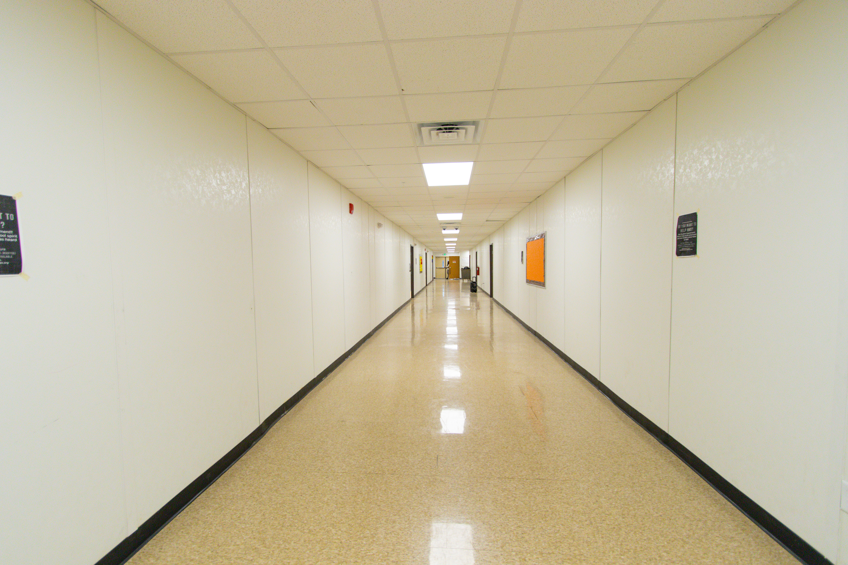
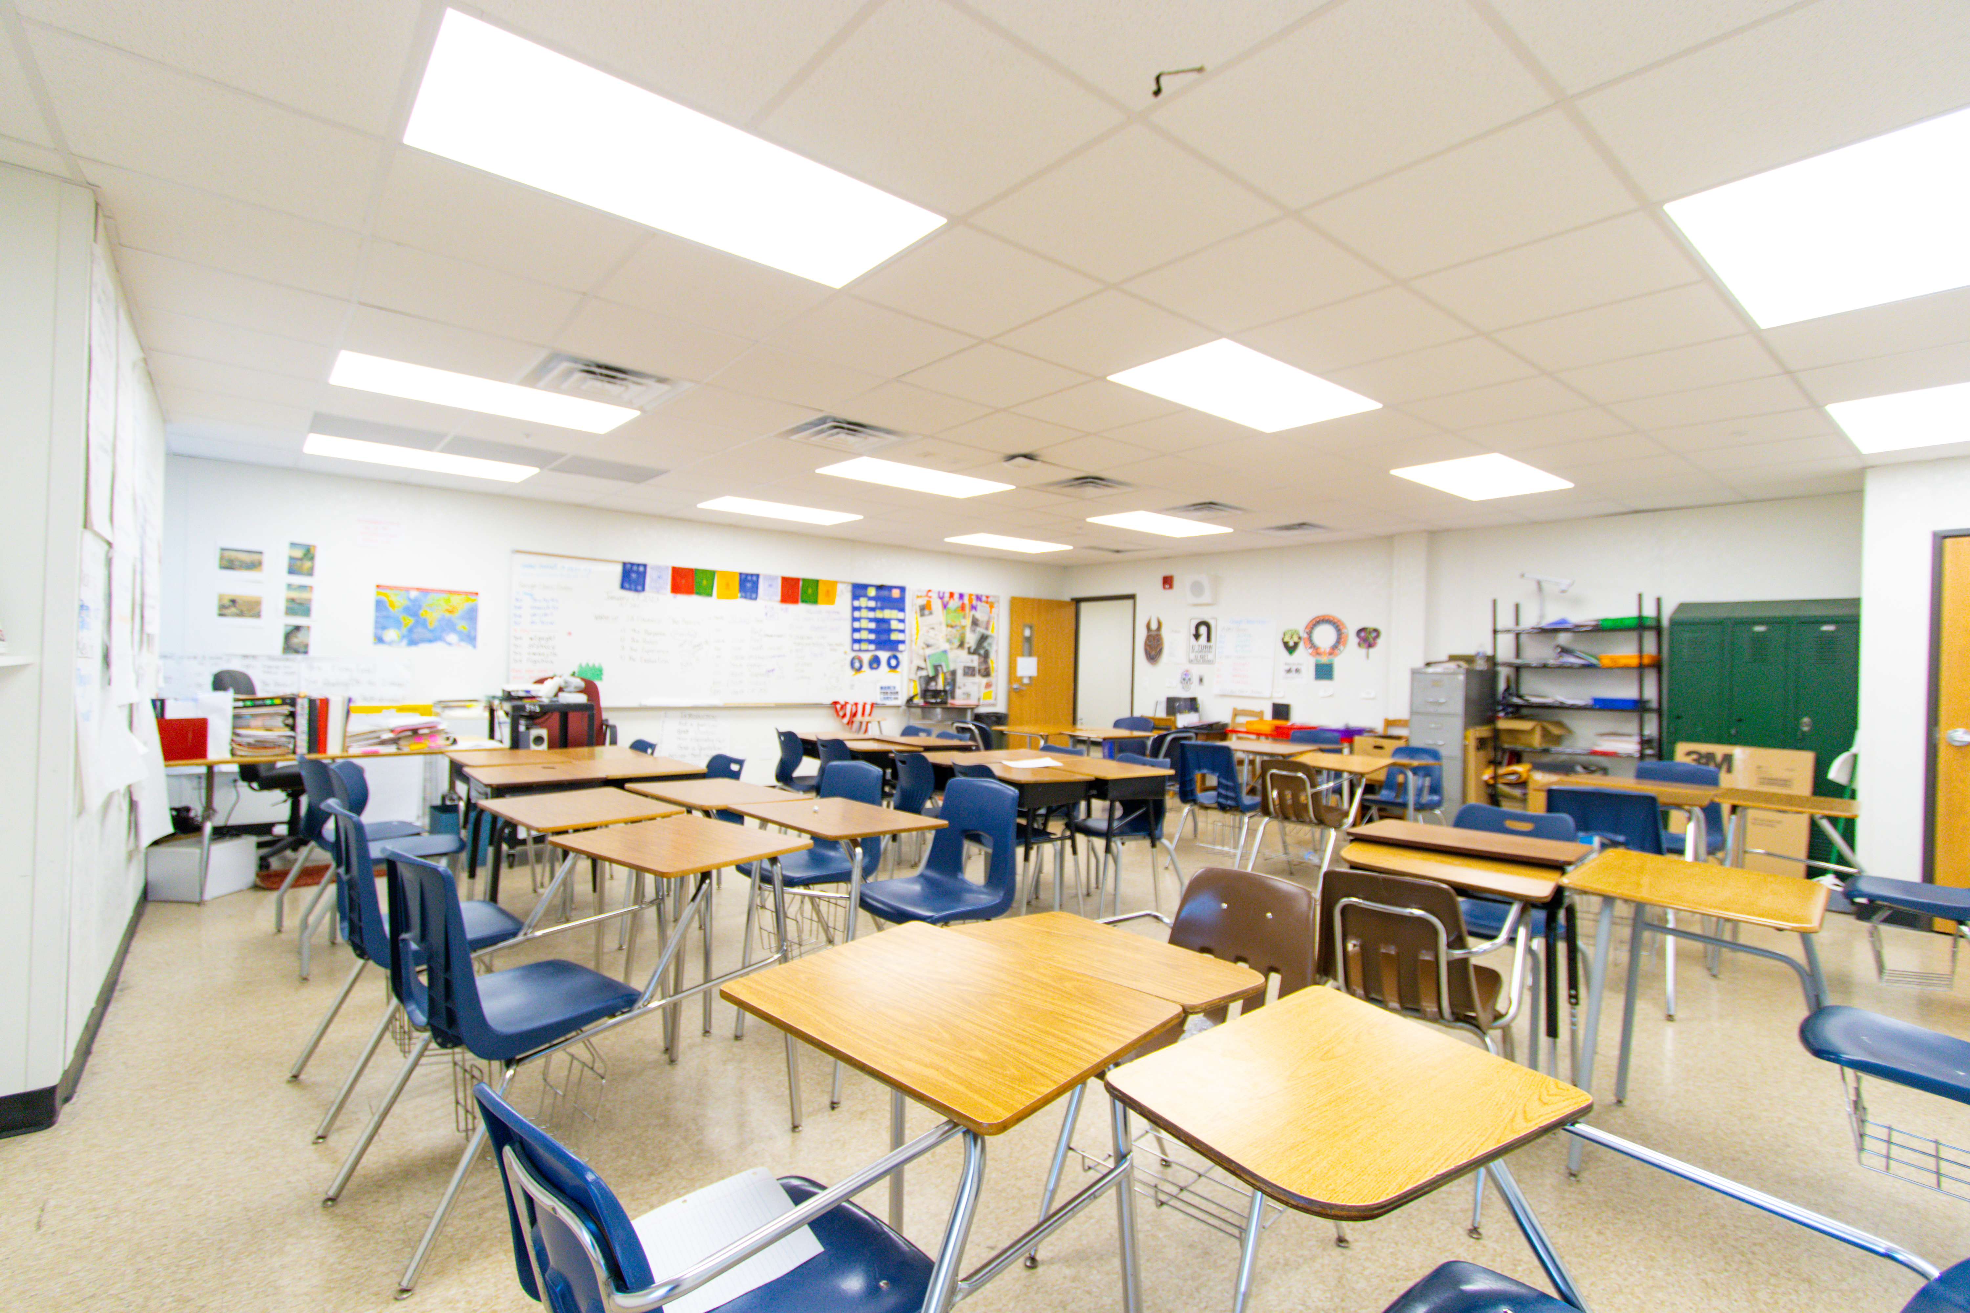
Modular Placement/Aesthetics

Slide 6
Potomac Landing Facility Enhancements
LED lighting replacement
Repainting of school interior
New playground
Installation of new ai-capable security cameras
Frontage improvements
Sidewalk Widening
Tree planting/Modular Screening
Bike lane

Slide 7
Modular Construction Timeline
November - July 2026
Final permit approval
Sediment and Erosion Controls
Stormwater Management Installation
Foundations
Modular Placement
June - July 2026
John Hanson moves to Potomac Landing
August 2026
John Hanson Montessori at Potomac Landing Opens

Slide 8
Operations
Building Services
Transportation
The bell times will remain the same (9:30 A.M.- 4:10 P.M.).
The number of bus routes would relatively remain the same. To be confirmed when boundaries are confirmed in the late Spring by Pupil Accounting.
Safety and Security will utilize its current staffing criteria to support John Hanson. At this time it calls for one (1) Safety and Security assistant. There is additional security support and personnel deployed at Colin Powell.
Traffic and Speed Mitigation: to be addressed by the Department of Public Works and Transportation

Slide 9
Discussion
QUESTIONS

